Slide 1

ADAS Engineering China Training
[L2 MFC Sense Function – HLA and TSA]
Chassis & Safety | Advanced Driver Assistance Systems

Slide 2
Training Target
Target Group
(Level of participant before the training)
L1 New
L2 Basic
Training Target
(what can be achieved/gained after having the training)
Help participants to reach skill level 3 Advanced
Know more about functions algorithm and behavior

Slide 3
Training Agenda
The detection module – LSD(Light Source Detection)
Function introduction – HLA(Head Light Assist)
The detection module – SR(Sign Recognition)
Function introduction – TSA(Traffic Sign Assist)

Slide 4
HLA Algorithm Architecture

Slide 5
LSD
Basic recognition will provide the information of lights such as..
Position
3D Motion
Classification
Pair track information

Slide 6
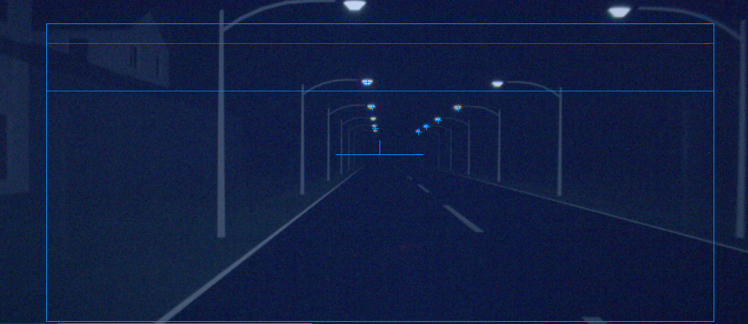
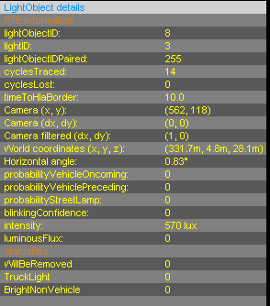
LSD

Slide 7
LSD: Segmentation
The segmentation searches for spots of local brightness maxima in the ROI of the image.
The output of the segmentation is a light object list, with the following information
Intensity
RGB-color
Position
Size

Slide 8
Detail of Segmentation (1/3)
R | G | R | G | R
G | B | G | B | G
R | G | R | G | R
G | B | G | B | G
R | G | R | G | R
Input of segmentation come from imager
The raw data will provided by the Bayer Pattern
Segmentation finds the high intensity pixels as light objects
Use red-color only to detect intensity(for performance)
Skip the non-red data to reduce using the resource.
To keep the performance with limited hardware resource, kind of filtering need to reduce the memory and calculation.
Step will be Segment by lines -> convert lines to region -> create light object list
Basic classification also calculated
Basic pair-light estimation
Only from the intensity and position
The image of Bayer Pattern.

Slide 9
Detail of Segmentation (2/3)
Segment lines:
Segment each line to segmented line
Find maxima for each segmented lines
Intensity leveled for 3 steps. Light is find if the level is changed.
The threshold of the level will be change after the one cycle of segmentation, to get better segmentation result with different ambient brightness.
The highest intensity level will be center of light. If same level continues, center of those detected as one light.
Intensity
Maxima | Maxima Position | L1 - length | L2- length | L3- length
30 | [2] | 1
180,30 | [2],[6] | 2,2 | 1,0
30,255 | [2],[7] | 1,4 | 0,2 | 0,2
120 | [7] | 3 | 1
30 | [6] | 1
0 | 0 | 30 | 0 | 0 | 0 | 0 | 0 | 0 | 0
0 | 60 | 180 | 0 | 0 | 0 | 30 | 30 | 0 | 0
0 | 0 | 30 | 0 | 0 | 30 | 180 | 255 | 30 | 0
0 | 0 | 0 | 0 | 0 | 0 | 80 | 120 | 30 | 0
0 | 0 | 0 | 0 | 0 | 0 | 30 | 0 | 0 | 0
Lv3
160
Graph is built from red marked column
Lv2
100
Lv1
50
Center of the light
Center of the light

Slide 10

Detail of Segmentation (3/3)
Convert lines to region:
Look rows to find the place of light objects.
Intensity (blanks are out of calculation)
Maxima | Maxima Position | L1 - length | L2- length | L3- length
30 | [2] | 1
180,30 | [2],[6] | 2,2 | 1,0
30,255 | [2],[7] | 1,4 | 0,2 | 0,2
120 | [7] | 3 | 1
30 | [6] | 1
 |  | 30
 |  | 180 |  |  |  | 30
 |  | 30 |  |  |  |  | 255
 |  |  |  |  |  |  | 120
Create light object list:
Light object list is separated for each level
One region will be one light object
Intensity
Position
Intensity (blanks are out of calculation)
LV1
30 | (6,1)
LV2
Lv3
180 | (2,1)
255 | (7,2)
 |  | 180 |  |  |  | 30
 |  |  |  |  |  |  | 255

Slide 11
LSD: Tracking
The tracking is “observing” the behavior of light objects over time.
Each detected light object is associated with a single light track, based on previous track information.
Light objects without association create new light tracks.
The output of the tracking are light tracks, with following information
Light object information
3D-Position (distance)
Motion (2D/3D)

Slide 12
Detail of Tracking
Track each light objects over time
Simple flowchart
Dead track flag is set the end of tracking part and will be removed at next frame.
Tracking use the SLAM, the algorithm of tracking estimated from ego motion
Find the similar light object and match to the tracking
The light near the track will be match
The characteristic of the light is also important for matching
Association will decide which light to track
Tracking up to 85
If the tracking goes to max, the prior light will be tracked
Priority will be decided by light information (e.g. distance)
Predict tracks
Associate tracks
to lights
Update track infos
Add new track
Add new pair

Slide 13
LSD: Analysis
The analysis attaches classification information to light tracks, based on characteristic features, for further detection of
Vehicles (oncoming or leading traffic)
City
Highway
Tunnel
The output of the analysis are
Object list
City data
Highway data
Tunnel data

Slide 14
Detail of Analysis
The vehicle analysis detects oncoming and leading traffic and distinguishes them from reflectors and other active lights such as street lamps.
Each light track is processed in four different stages
In the base level the basic features for further processing are extracted
In the 1st level a low level classification is performed on features like intensity, color, motion or temporal behavior
In the 2nd level a high level classification is performed on features like the shape
In the 3rd and final level the driving directions of the vehicles are detected

Slide 15
HLA
The function module interprets the output of the
Image processing
Blockage detection
Current situation, e.g. driving situation
The variant selection control the illumination characteristics of the head lamps depending on the HLA variant
HLA light
HLA (standard)
HLA plus

Slide 16
HLA Turn Off Reason
HLA has following factories to decide behavior.
Ambient brightness
Velocity
City
Tunnel
Object Vehicle
Blockage

Slide 17

QUESTIONS

Slide 18
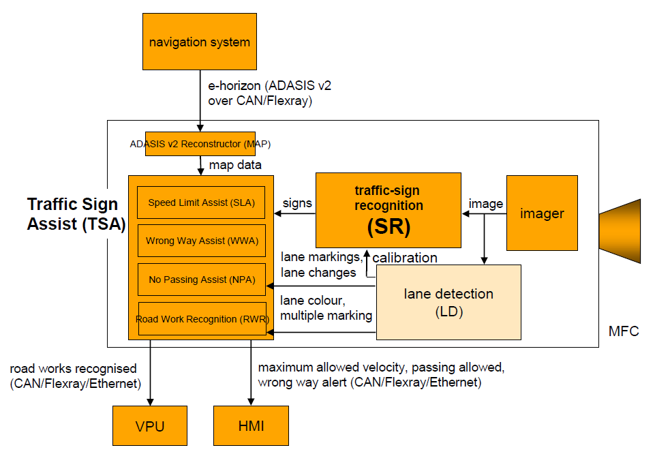
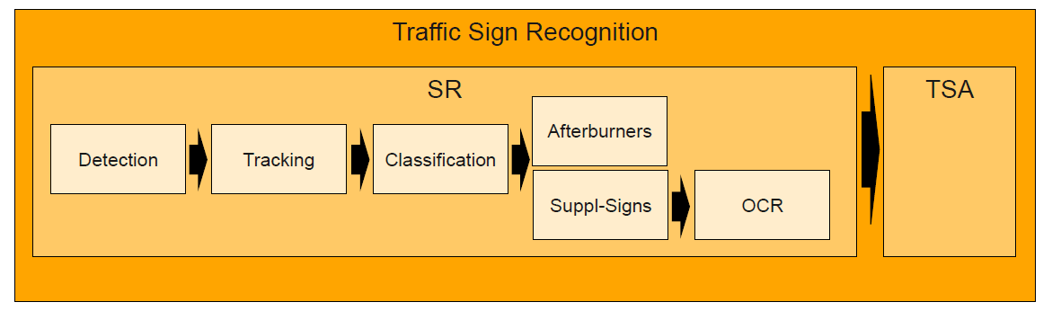
TSA Algorithm Architecture

Slide 19
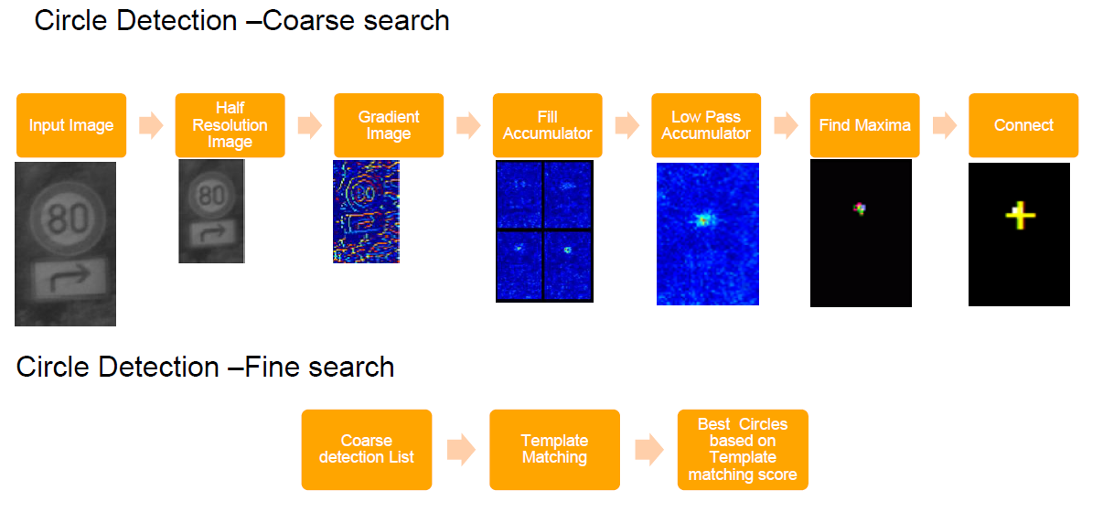
SR
Detection

Slide 20
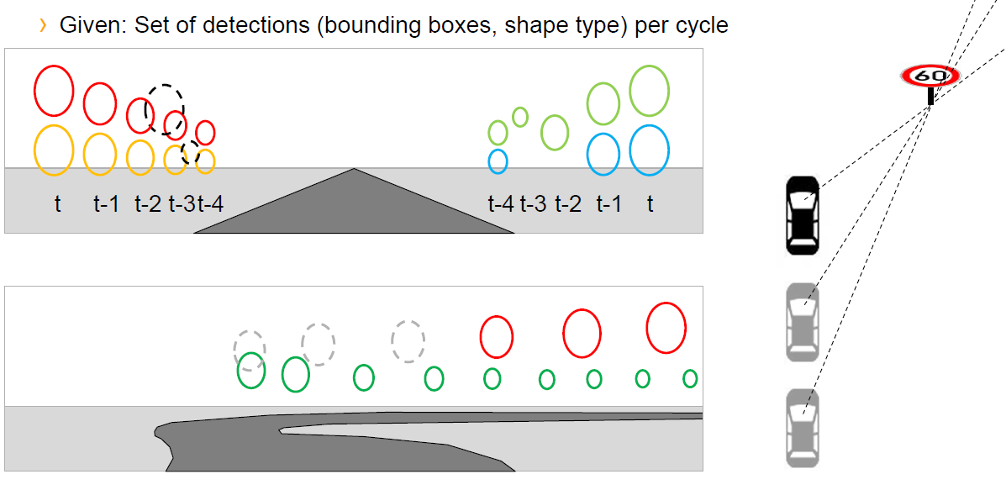
SR
Tracking

Slide 21
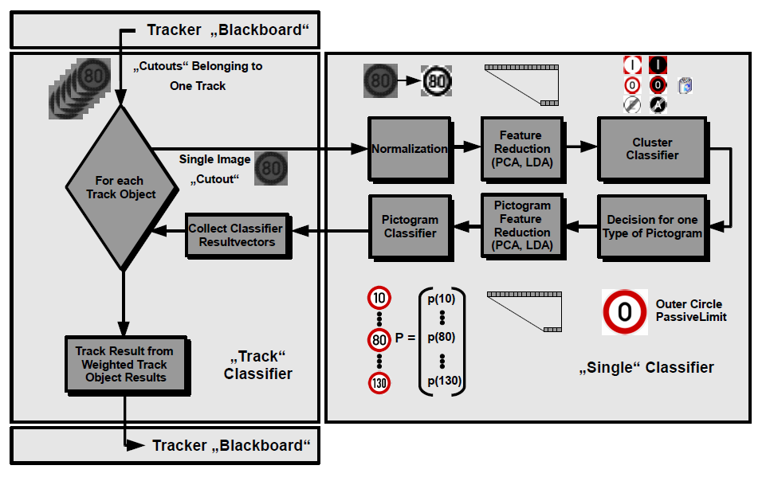
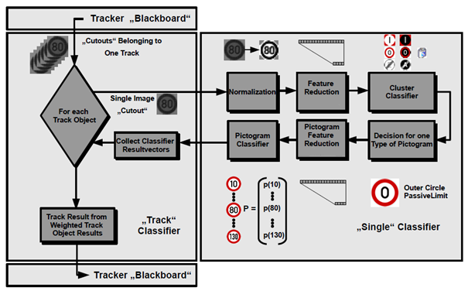
SR
Classification

Slide 22
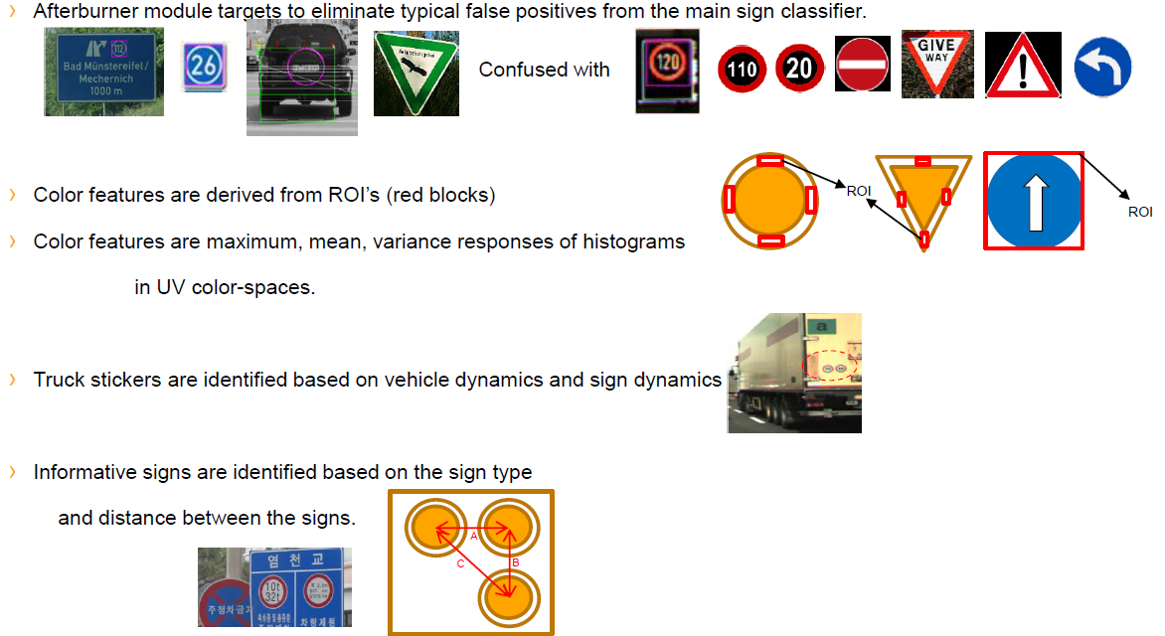
SR
Afterburner

Slide 23
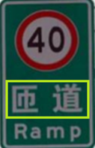
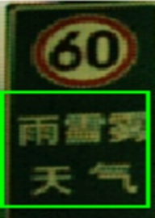
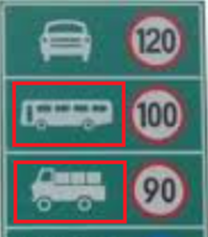
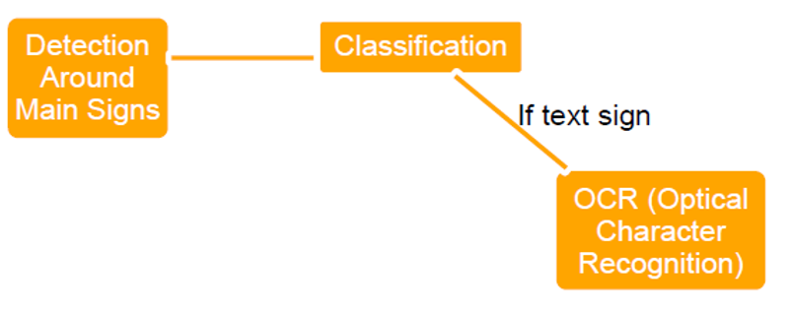
SR
Supplementary Sign

Slide 24
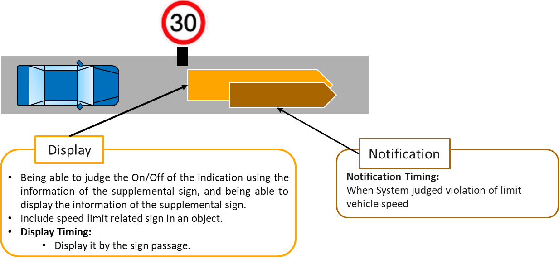
TSA
Traffic Sign Assist is a kind of driver assistance function which makes use of (country-specific) traffic rules to interpret the recognized traffic signs and issues resulting information to the driver (e.g. speed limit cancellation while overtaking is still forbidden).

Slide 25
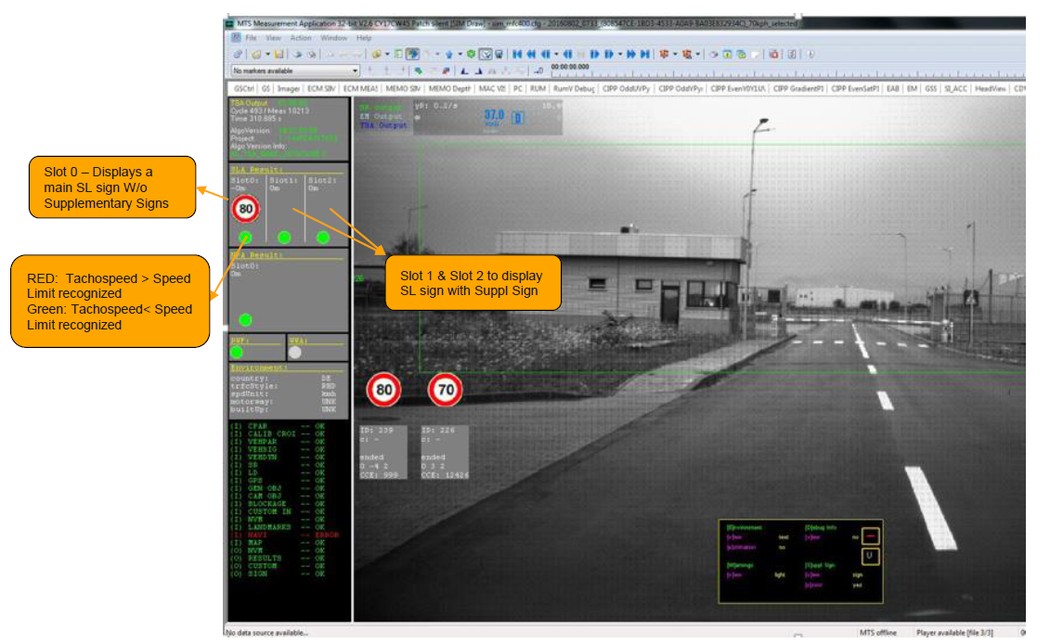
TSA
MTS Visualization

Slide 26
QUESTIONS

Slide 27

Thank you for your attention!
FEEDBACK:
Please share your feedback by the following link or by scanning the following QR-code:
https://www.wjx.cn/jq/42915896.aspx
Please finish before you leave the class room. Thank you ☺
TRAINER CONTACT INFO:
Name: Yefei Wei
Skype: Yefei, Wei(uia70152)
Office Phone:3916 5785
Name: Zhongwen Ye
Skype: ye, zhongwen03(uib65042)
Office Phone:3916 5623

